Slide 1
Indiana Food and Fuel Association Briefing

Slide 2
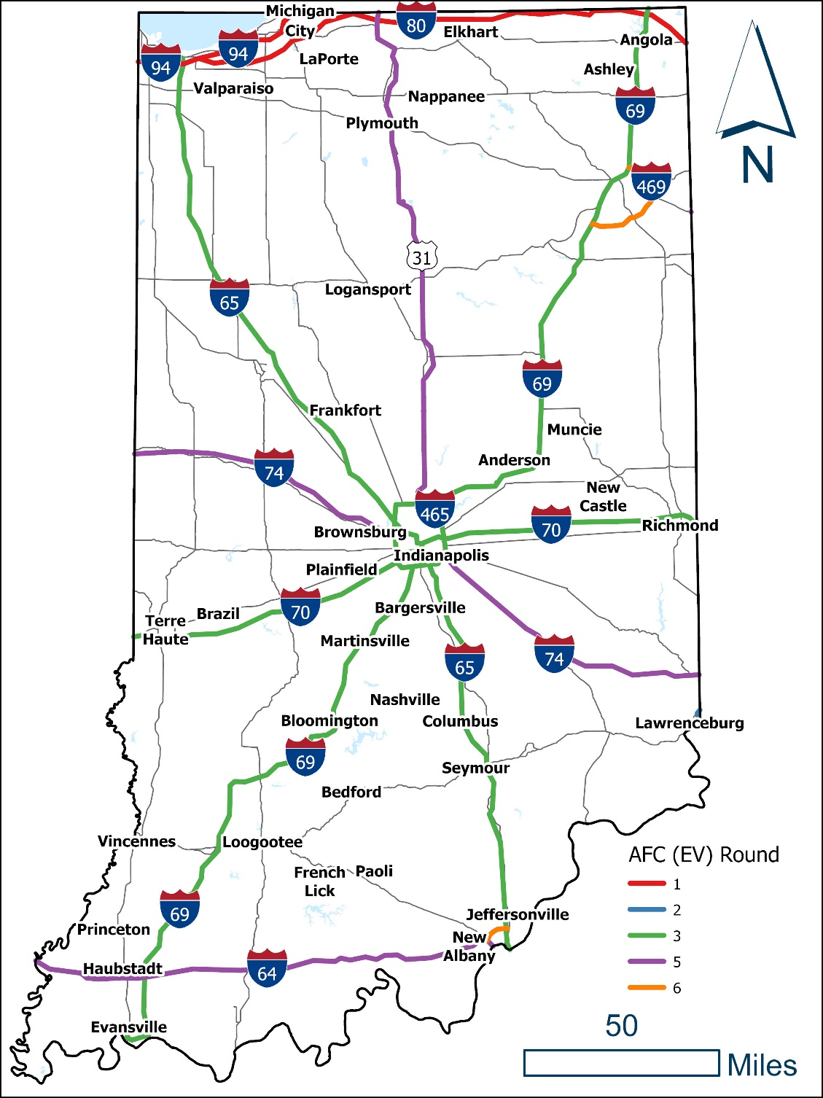
Introduction
NEVI Program Overview and Goals:
2021 Bipartisan Infrastructure Law (BIL)
Goal: create nationwide network of 500,000 EV chargers by 2030
Funding:
$7.5B ($5B formula, $2.5B discretionary) over 5 years
Indiana = $99,605,738
Key Requirements:
Every 50 miles along State’s interstate highway system, within 1 mile of the Interstate
EV charging infrastructure must include at least four 150KW Direct Current (DC) Fast Chargers
Rest areas are not eligible locations
States are allowed to contract with private entities for installation, operations and maintenance
Approach:
Existing research
Stakeholder engagement
Plan development and review
Notes:
What is NEVI? National Electric Vehicle Infrastructure.
Created by November 2021 passage of the BIL
Goal: to create a national network of 500,000 EV chargers by 2030
Key guidelines:
prioritizes funding along an AFC (which is an FHWA-designated highway segment that has infrastructure (or plans for it) that support alternative fuel options.
Provides minimum standards for EV charging stations
Requires compliance with Justice 40
NEVI program contains both formula (guaranteed) funding (about $5B over 5 years) and discretionary (competitive) (about $2.5B over 5 years)
Indiana’s formula funding under NEVI is just under $100M over five years.
Under NEVI guidance, states could nominate additional AFCS (these nominations were due May 13). States are also required to submit a statewide implementation plan that is due Aug 1. FHWA will review and approve the plans by Sept 30 to release the formula funding to the states.
This slide summarizes some of the key NEVI guidelines for EV charging stations. These include:
EV charging stations must be located every 50 mi along the interstate
Stations must be within 1 mile of the interstate
Each station must provide a minimum of 4 plugs/ports, each providing 150kW of power through a DC power source (DC provides more consistent voltage as opposed to AC)
Rest areas are NOT eligible locations
States are allowed to contract with private entities for installation, operations and maintenance of EV charging stations/

Slide 3
Plan Overview
Chapter | Title
1 | Introduction
2 | State Agency Coordination
3 | Public Engagement
4 | Plan Vision and Goals
5 | Contracting
6 | Existing and Future Condition Analysis
7 | EV Charging Infrastructure Deployment
8 | Implementation
9 | Civil Rights
10 | Equity Considerations
11 | Labor and Workforce Considerations
12 | Cybersecurity
13 | Program Evaluation
14 | Discretionary Exceptions
Notes:
Federal NEVI guidance is prescriptive about the state plan, specifying these fourteen sections. This specificity ensures minimum requirements are met.
Initial sections discuss the state’s approach to building out the plan, specifically how they coordinated with other state agencies, and the public and private sectors, including disadvantaged and underserved areas.
Sections 6-8 provide details around how services and support will be procured and what implementation looks like in terms of locations for planned infrastructure.
Sections 9-12 ensure requirements around relevant civil rights laws such as Title 6 and ADA as well as Justice 40 are met, in addition to states laying out the approach for ensuring the training, experience and diversity of the workforce involved in installing and maintaining the EV charging infrastructure.
Cybersecurity details how customer’s personal information is protected while they use charging stations, and program evaluation describes the data collection and methodology to ensure goals are measured and met.

Slide 4
Performance Measures
Performance Measure | Target
Percent of Alternative Fuel Corridors miles that are within 50 miles of a charging station | 100%
Percent of Indiana’s population that is within 35 miles of a charging station | 100%
Number of sites implemented | TBD
Number of ports implemented | TBD
Percent of time at least one port is available at all sites | TBD
Data Collection and Analysis
Program Evaluation
Notes:
Federal NEVI guidance requires at least one quantifiable goal. Of the goals I presented on the previous slide, INDOT is proposing five potential measures that align with two of the goals/
Reduce range anxiety:
Ensure all 50 mile gaps along the AFCs are filled
Ensure all of Indiana’s residents are within a certain number of miles of a charging station. Current math looks like this is less than 50 miles (as you will see in a few sildes)
Create robust and reliable charging infrastructure:
We will measure the number of sites
The total number of ports
Up time of ports at stations
It is likely these measures will be adapted to set specific targets over the next five years, but this is still in development.

Slide 5
Public Engagement
KEY ACTIVITIES AND SCHEDULE
Request for Information (closed April 29)
AFC nominations (submitted May 2)
Virtual open house (May 11)
Slides: https://www.in.gov/indot/files/INDOT-NEVI-Virtual-Open-House_Final_V2.pdf
Public Survey (closed May 27):
Over 2,000 responses received
Utility questionnaire (INDOT and OED) (closed June 8)
In person meetings:
June 2: Northern Indiana
June 9: Central Indiana
June 14: Southern Indiana
One on one meetings (March 2022 to present)
Virtual public walkthrough (July 13)
Notes:
To date, the following outreach has been conducted.
The Indiana Department of Transportation and the Indiana Office of Energy Development released an RFI which closed on April 29, collecting comments and data for consideration in the drafting of the State EV Implementation Plan. INDOT received over 40 responses which are currently being reviewed. We expect an overview of the RFI responses to be made public by mid July.
On May 11 INDOT held a Virtual open house webinar introducing the NEVI program and outlining the strategy behind the plan development and public engagement. The webinar slides and recording are linked on this slide and available on the INDOT NEVI program web page.
An online public survey was released and closed May 27 to gather direct feedback from stakeholders. We received over 2,200 responses with the majority coming from community members.
A questionnaire was developed to gather vital information from Indiana’s Utility groups relating to funding and incentives, site installation and connection, equity and environmental justice, energy generation, and strategic and long-term planning. Responses were due June 8.

Slide 6
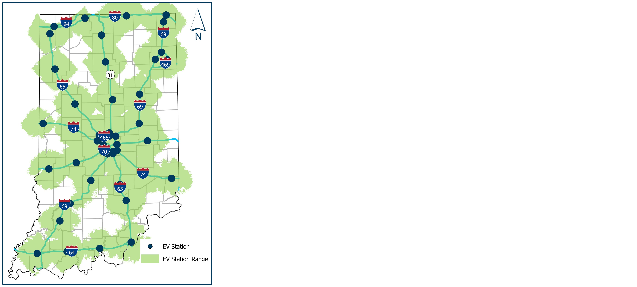
Preliminary Charging Infrastructure
Preliminary charging locations are shown in blue with light green service areas
Service area shapes represent a 25-mile range
Overlapping service areas along the EV corridors demonstrate the AFC meets the NEVI criteria
44 Preliminary EV charging locations
With all preliminary charging locations shown, nearly the entire state of Indiana will be within 50-miles of a DCFC charging location
98% of Indiana residents will be within 35-miles of a DCFC location

Slide 7
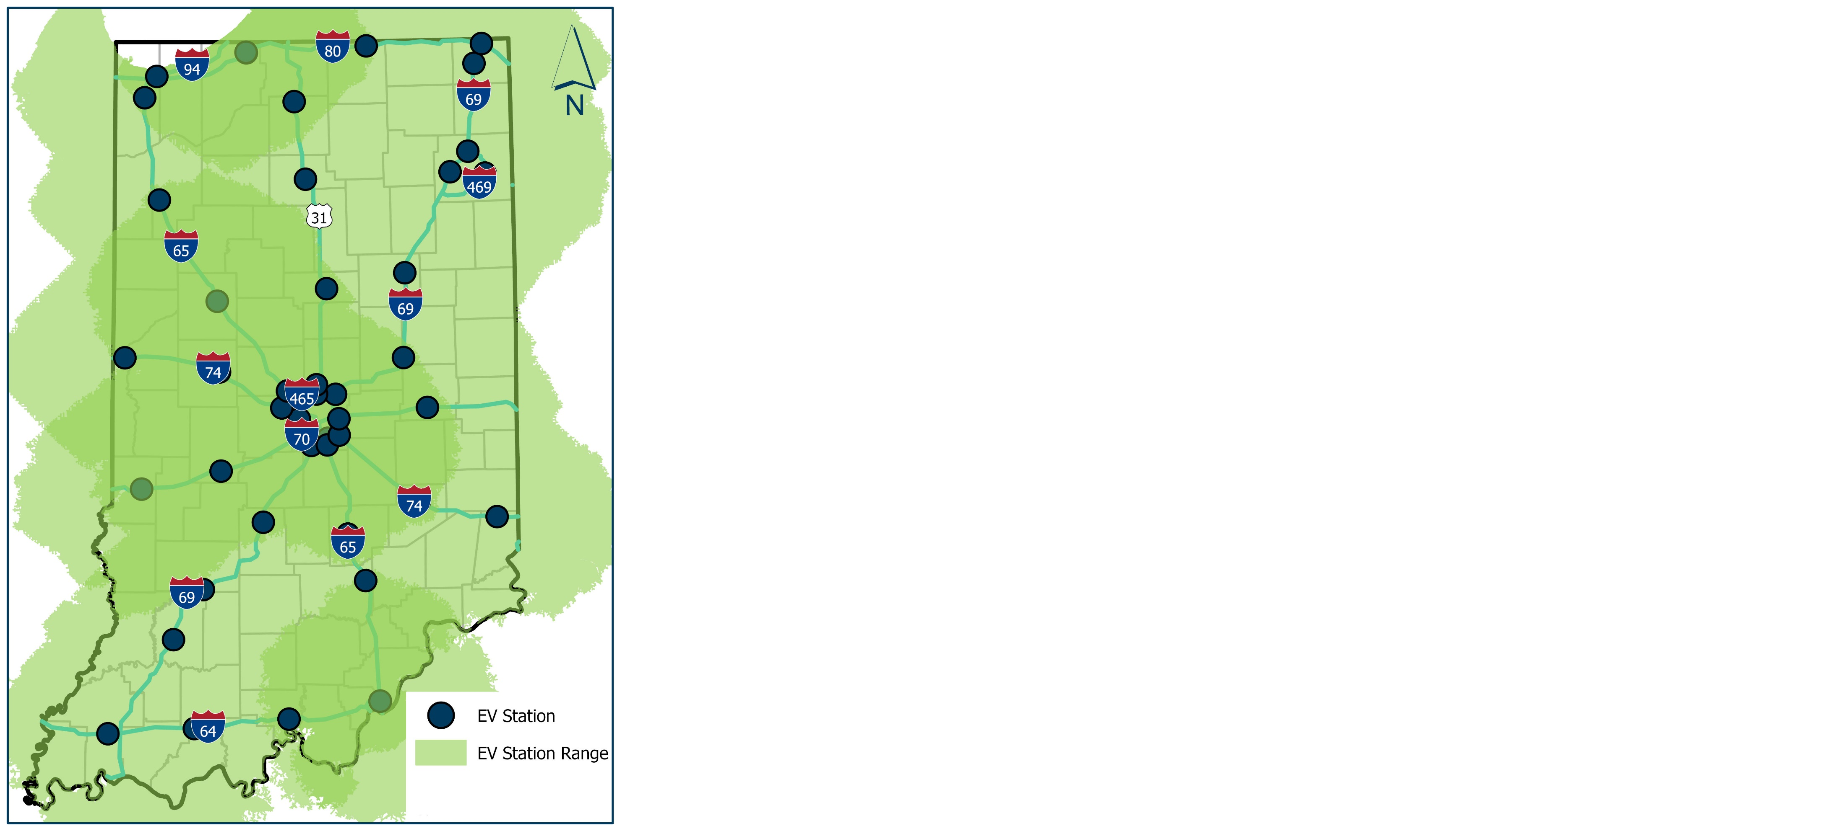
Preliminary Charging Infrastructure
With all preliminary charging locations shown, nearly the entire state of Indiana will be within 50-miles of a DCFC charging location
98% of Indiana residents will be within 35-miles of a DCFC location

Slide 8
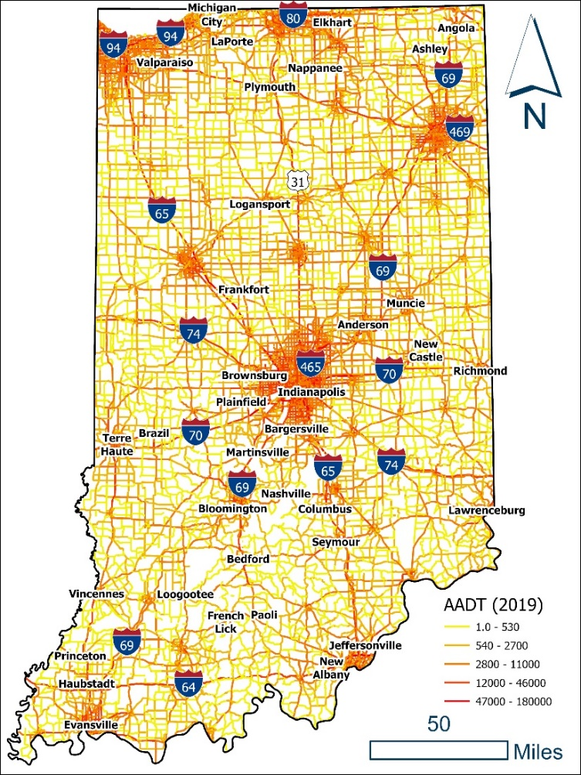
State Travel Patterns
Notes:
Looking at our state travel patterns is key to understanding the potential proritizaiton of preliminary locations. On the left is the AADT (INDOT, 2019), which clearly who a majority of travel in incorporate, urban areas. The map on the right shows dwell time sessions (stops of more than ten minutes) analyzed by Purdue University using 3rd party connected vehicle day. As with where the miles are driven, this shows the stops also aligning with urban, incorporated areas.
Right: CV Dwell Time Sessions (Purdue, May 2022)

Slide 9
Equity (Benefits)
Percent of AFC miles that are within 50 miles of a charging station (and AFC miles in a DAC community). The goal for proximity is 100%.
Percent of Indiana’s population (and DAC community population) that is within 40 miles of a charging station. The goal is 100%.
Metrics for robust and reliable infrastructure (apply to all stations regardless of location).
Number of sites implemented (total and in and near a DAC)
Number of ports implemented (total and in and near a DAC)
Percent of time at least one port is available at all sites (total and in and near a DAC)
ASSESSEMENT OF PRELIMINARY LOCATIONS:
100% of the preliminary sites are in or within 15-miles of at least one DAC area
62% the preliminary sites are in or within 5 miles of DAC area

Slide 10
Contracting Overview
Strategy:
Competitive procurement process
Incremental release of RFPs
Multiple sites in each release
Assumptions:
20% match - leverage private sector contributions
INDOT will not operate or maintain
5-year minimum O&M
2022-2023
Prioritization of preliminary sites
2023-2024
Procurement of Phase 1 sites
2024-2025
1. Implementation of Phase 1 sites
2. Procurement of Phase 2 sites
2025 -2027
1. Implementation of Phase 2 sites
2. Procurement for Phase 3
3. Full build out of AFCs
NOTE: TIMEFRAME IS APPROXIMATE
Notes:
One of the FAQs has been how and when INDOT will handle the procurement of and distribution of funds.
Formula funding will be allocated to INDOT incrementally – each year of the five year program. INDOT is anticipating using a competitive procurement process that will be repeated incrementally over the five years. It is likely that each procurement will contain multiple sites although the groupings and prioritization is still in the planning stages.
From a timeframe perspective, INDOT will complete this additional planning work over the next year. Procurement of the sites is tentatively slated to begin in 2023 with the Phase 1 sites. In 2024 – 2025 while Phase 1 sites are implemented, procurement of Phase 2 sites will begin. Finally, from 2025-2027, implementation of Phase 2 sites will begin while procurement for Phase 3 sites begins. Ideally, all sites are procured and implemented within the five years.
Note that specific number of phases is still TBD and these timeframes are approximate.

Slide 11
Q & A
National Electric Vehicle Infrastructure

